Slide 1


Anais Velazquez
October 21, 2024

Slide 2

Outline
Executive Summary
Introduction
Methodology
Results
Conclusion
Appendix

Slide 3
Executive Summary
We used these data science methodologies:
Collecting data
Data Wrangling
Exploratory Analysis using different tools
Visual Analytics
Predictive Analysis
To discovered the price for each launch and see if the first stage will land successfully, using the data science methodologies listed above.

Slide 4
Introduction
Space Y that would like to compete with SpaceX. Space Y was founded by Billionaire industrialist Allon Musk.
In this project, we wanted to find out a couple of things that makes SpaceX successful. Firstly, we needed to gather information about Space X and determine if SpaceX will reuse the first stage. As well as if the first stage lands successfully. To find out this information, we trained a machine learning model and used public information to predict if SpaceX will reuse the first stage.
In additional we also wanted to determine the cost of each launch.

Slide 5

Section 1

Slide 6
Methodology
Executive Summary
Data collection methodology:
SpaceX REST API (capsules, cores, launches/past)
Perform data wrangling
Normalized the data from JSON to CSV.
Cleaned data (NULLs)
Sampling data
Perform exploratory data analysis (EDA) using visualization and SQL
Perform interactive visual analytics using Folium and Plotly Dash
Perform predictive analysis using multiple classification models.

Slide 7
Data Collection
We collected using SpaceX REST API, specifically on capsules, core, past launches, boosters, launchpad, and payload.
Using these APIs we found information on:
Booster version
Launch site (name of site, longitude, and latitude)
Payload mass and orbit
etc.
We also conducted web scraping using Wikipedia provide tables on launch records.

Slide 8
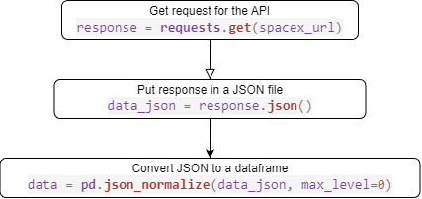
Data Collection – SpaceX API
Here is the API call using past launches to get the information on all past launches' details.
GitHub

Slide 9
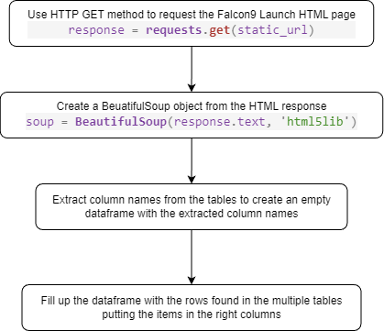
Data Collection - Scraping
We using the “List of Falcon 9 and Falcon Heavy launches” Wikipedia page we took launch information from 2010-2021.
GitHub

Slide 10
Data Wrangling
In order to clean up the data I did the following:
Checked for NULLs within the dataframe, none were found.
Created a variable that represented the classification variable on the outcome of the launch.
The variable was name class and had two classifications, 0 and 1. The meaning of 0 might the first stand did not land successfully, while the 1 meant it did land successfully.
GitHub

Slide 11
EDA with Data Visualization
The plots created through EDA with Data Visualization are:
Scatterplots:
Flight Number vs Payload Mass (kg)
Flight Number vs Launch Site
Launch Site vs Payload Mass (kg)
Flight Number vs Orbit
Orbit vs Payload Mass (kg)
Orbit vs Success Rate bar plot
Year vs Success Rate line plot
GitHub

Slide 12
EDA with SQL
Unique launch sites used in the space mission
SELECT DISTINCT LAUNCH_SITE FROM SPACEXTABLE
Launch sites begin with the string 'CCA’
SELECT * FROM SPACEXTABLE WHERE LAUNCH_SITE LIKE 'CCA%' LIMIT 5
Total payload mass carried by boosters launched by NASA (CRS)
SELECT SUM(PAYLOAD_MASS__KG_) AS 'TOTAL PAYLOAD MASS BY NASA (CRS)' FROM SPACEXTABLE WHERE CUSTOMER = 'NASA (CRS)'
Average payload mass carried by booster ver. F9 v1.1
SELECT AVG(PAYLOAD_MASS__KG_) AS 'AVERAGE PAYLOAD MASS BY BOOSTER VER. F9 V1.1' FROM SPACEXTABLE WHERE BOOSTER_VERSION = 'F9 V1.1'
Date of the 1st successful landing on a ground pad
SELECT DATE AS 'FIRST SUCCESSFUL LANDING OUTCOME ON GROUND PAD' FROM SPACEXTABLE WHERE LANDING_OUTCOME LIKE '%SUCCESS%GROUND%' LIMIT 1

Slide 13
EDA with SQL
List of names of the boosters which have success in drone ship and have payload mass greater than 4000 but less than 6000.
SELECT BOOSTER_VERSION AS 'BOOSTERS IN SUCCESSFUL DRONE SHIP LANDINGS W/ 6000>PAYLOAD MASS>4000' FROM SPACEXTABLE WHERE LANDING_OUTCOME LIKE '%SUCCESS%DRONE%' AND PAYLOAD_MASS__KG_ > 4000 AND PAYLOAD_MASS__KG_ < 6000
Total number of successful & failure missions
SELECT MISSION_OUTCOME, COUNT(*) AS COUNT FROM SPACEXTABLE GROUP BY MISSION_OUTCOME
List of names of the booster that have carried the maximum payload mass
SELECT DISTINCT BOOSTER_VERSION AS 'BOOSTER VERSIONS W/ THE MAX PAYLOAD MASS' FROM SPACEXTABLE WHERE PAYLOAD_MASS__KG_ = (SELECT MAX(PAYLOAD_MASS__KG_) FROM SPACEXTABLE)

Slide 14
EDA with SQL
List the records which will display the month names, failure landing outcomes in drone ship, booster versions, launch site for the months in year 2015.
SELECT SUBSTR(DATE,6,2) AS MONTH, LANDING_OUTCOME, BOOSTER_VERSION, LAUNCH_SITE FROM SPACEXTABLE WHERE LANDING_OUTCOME LIKE '%FAILURE%DRONE%' AND SUBSTR(DATE,0,5) ='2015’
Rank the count of landing outcomes between the date 2010-06-04 and 2017-03-20, in descending order.
SELECT LANDING_OUTCOME, COUNT(*) AS COUNT FROM SPACEXTABLE WHERE DATE BETWEEN '2010-06-04' AND '2017-03-20' GROUP BY LANDING_OUTCOME ORDER BY COUNT DESC
GitHub

Slide 15
Build an Interactive Map with Folium
On the interactive map using Folium you will see
Markers that are used to mark where the launch sites are on the map
Circle are used to show the launches that were successful and failures at each launch sites
Lines are used to calculate the proximity of other landmarks from the launch sites
GitHub

Slide 16
Build a Dashboard with Plotly Dash
On the dashboard, you will see the following plots:
A pie chart with a dropdown menu that shows
All sites comparison of successful launches
Each individual launch site comparison between successful and failure launches
A scatterplot with a slider that sets the payload range.
Relation between the mission outcome and the payload mass. The color of each data point is also marked for booster version category.
GitHub

Slide 17
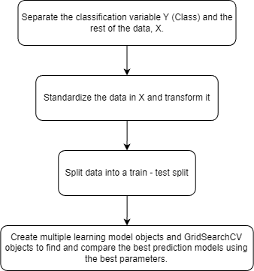
Predictive Analysis (Classification)
When creating the prediction models, we used the flowchart to create them. We different predictive models we used are:
Logistic Regression
Support Vector Machine
Decision Tree
K-nearest Neighbor
GitHub

Slide 18
Results
Exploratory Data Analysis (EDA) Results
Orbits that have been 100% successful were ES-L1, GEO, HEO, and SSO.
Success rate was rising in 2013 – 2017, except 2014 where it was stable.
Most mission outcomes were successful except for 1 failure.
Predictive Analysis Results
The decision tree model had the highest accuracy and best score.
Accuracy : 0.8892857142857145
Score: 0.9444444444444444

Slide 19

Section 2

Slide 20
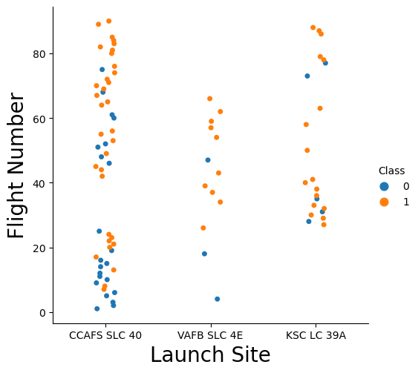
Flight Number vs. Launch Site
This scatter plot shows
The correlation between the number of flights and their launch sites
Whether the mission was a success or a failure via the color of the data points.
Orange/1 means the mission was a success and Blue/0 means it was a failure.
From the scatter plot we can see that CCAFS SLC 40 launch site had the most launches compared to the rest.

Slide 21
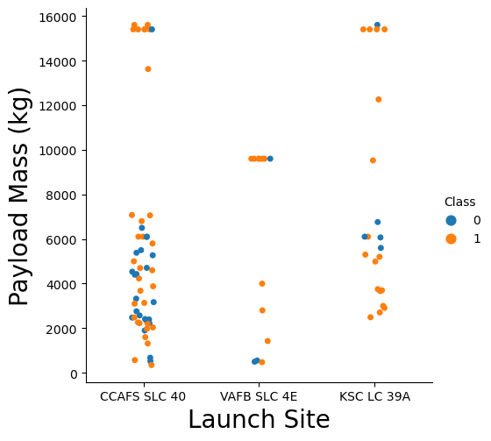
Payload vs. Launch Site
This scatter plot shows
The correlation between the payload mass in kg and their launch sites
Whether the mission was a success or a failure via the color of the data points.
Orange/1 means the mission was a success and Blue/0 means it was a failure.
From the scatter plot we can see that CCAFS SLC 40 and KSC LC 39A launch sites had the highest payload mass (<16000kg) while VAFB SLC 4E had its highest payload mass at <10000kg.

Slide 22
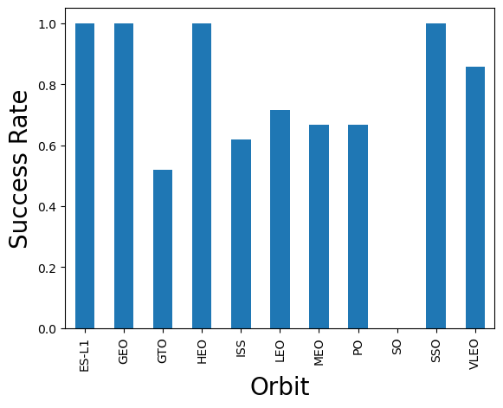
Success Rate vs. Orbit Type
This bar chart shows
The correlation between the success rate and the orbit the mission was set to.
From this bar chart we can see that the orbits that had a 100% success rate were ES-L1, GEO, HEO, and SSO. While SO had a lowest success rate at 0%.

Slide 23
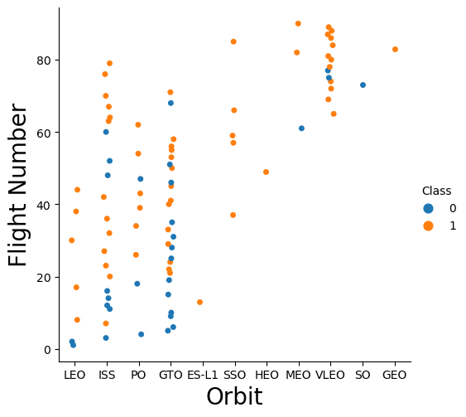
Flight Number vs. Orbit Type
This scatter plot shows
The correlation between the flight number and the orbit the mission was set to.
Whether the mission was a success or a failure via the color of the data points.
Orange/1 means the mission was a success and Blue/0 means it was a failure.
Taking what we learned from the last slide, we can see why the orbits with the highest success rate were high. Only 1 flight that were successful means the success rate 100%.
The only orbit that has >1 flight and a success rate of 100% is SSO, with 5 flights being successful in that orbit.

Slide 24
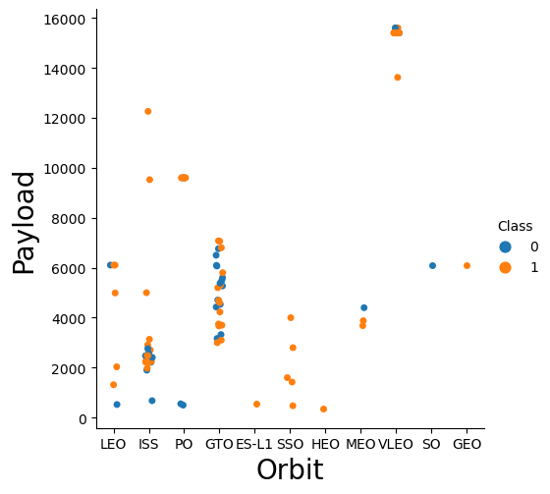
Payload vs. Orbit Type
This scatter plot shows
The correlation between the payload mass in kg and the orbit the mission was set to.
Whether the mission was a success or a failure via the color of the data points.
Orange/1 means the mission was a success and Blue/0 means it was a failure.
Taking what we learned from the last 2 slide, we can see that SSO having the highest number of flights with 100% success rate had a very low payload mass.
Similarly, the other launches that had 100% success rate are low in payload mass, as well.

Slide 25
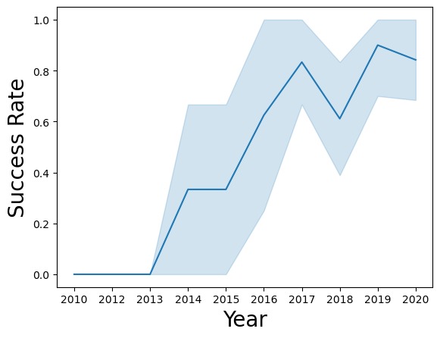
Launch Success Yearly Trend
This line graph shows
The correlation between the success rate and the year.
As we can see by the line graph the success rate since 2013 kept increasing till 2017 (stable in 2014) and after 2015 it started increasing. In 2018 the success rate took a dip then went back up in 2019.

Slide 26
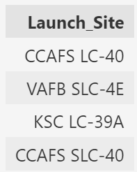
All Launch Site Names
Query: Unique launch sites used in the space mission
SELECT DISTINCT LAUNCH_SITE FROM SPACEXTABLE
This query shows the unique names of the launch sites in all the space missions for SpaceX. As we can see there are only four, CCAFS LC-40, VAFB SLC-4E, KSC LC-39A, and CCAFS SLC-40.

Slide 27
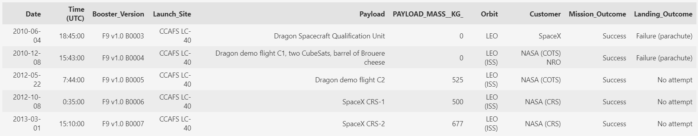
Launch Site Names Begin with 'CCA'
Query:
Launch sites begin with the string 'CCA’
SELECT * FROM SPACEXTABLE WHERE LAUNCH_SITE LIKE 'CCA%' LIMIT 5
This query shows the first 5 launches information that name begins with ‘CCA’.

Slide 28
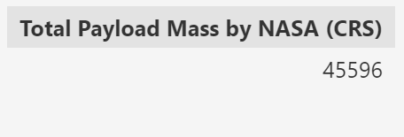
Total Payload Mass
Query: Total payload mass carried by boosters launched by NASA (CRS)
SELECT SUM(PAYLOAD_MASS__KG_) AS 'TOTAL PAYLOAD MASS BY NASA (CRS)' FROM SPACEXTABLE WHERE CUSTOMER = 'NASA (CRS)’
This query shows the total payload mass by NASA (CRS) which is 45596kg.

Slide 29
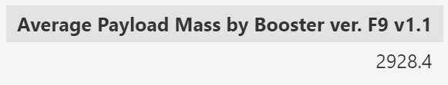
Average Payload Mass by F9 v1.1
Query:
Average payload mass carried by booster ver. F9 v1.1
SELECT AVG(PAYLOAD_MASS__KG_) AS 'AVERAGE PAYLOAD MASS BY BOOSTER VER. F9 V1.1' FROM SPACEXTABLE WHERE BOOSTER_VERSION = 'F9 V1.1’
This query shows that average payload mass carried by booster ver. F9 v1.1 is 2928.4 kg.

Slide 30
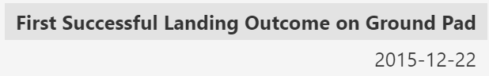
First Successful Ground Landing Date
Query:
Date of the 1st successful landing on a ground pad
SELECT DATE AS 'FIRST SUCCESSFUL LANDING OUTCOME ON GROUND PAD' FROM SPACEXTABLE WHERE LANDING_OUTCOME LIKE '%SUCCESS%GROUND%' LIMIT 1
This query shows date of the first successful landing outcome on a ground pad was December 22, 2015.

Slide 31
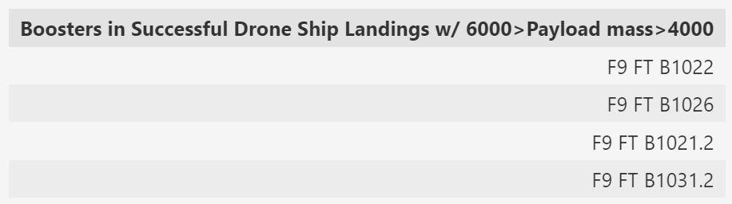
Successful Drone Ship Landing with Payload between 4000 and 6000
Query:
List of names of the boosters which have success in drone ship and have payload mass greater than 4000 but less than 6000.
SELECT BOOSTER_VERSION AS 'BOOSTERS IN SUCCESSFUL DRONE SHIP LANDINGS W/ 6000>PAYLOAD MASS>4000' FROM SPACEXTABLE WHERE LANDING_OUTCOME LIKE '%SUCCESS%DRONE%' AND PAYLOAD_MASS__KG_ > 4000 AND PAYLOAD_MASS__KG_ < 6000
This query shows that F9 FT B1022, F9 FT B1026, F9 FT B1021.2, and F9 FT B1031.2 were the boosters that have had a successful landing on a drone shop and have a 4000<payload mass<6000.

Slide 32
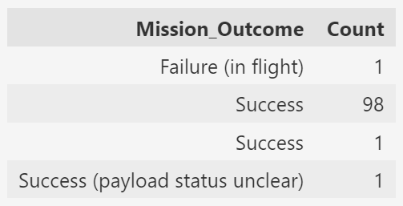
Total Number of Successful and Failure Mission Outcomes
Query:
Total number of successful & failure missions
SELECT MISSION_OUTCOME, COUNT(*) AS COUNT FROM SPACEXTABLE GROUP BY MISSION_OUTCOME
This query shows that only 1 mission outcome was a failure (in flight).

Slide 33
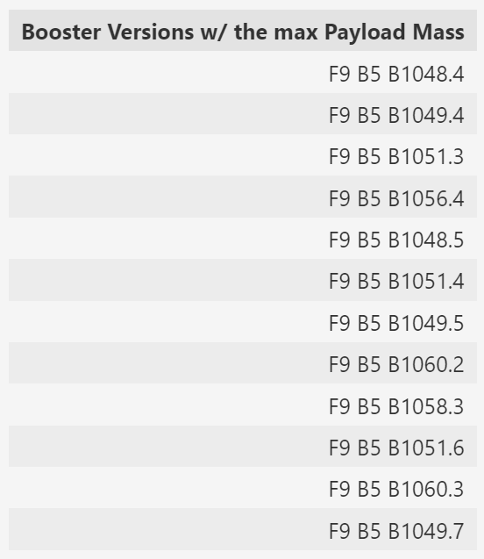
Boosters Carried Maximum Payload
Query:
List of names of the booster that have carried the maximum payload mass
SELECT DISTINCT BOOSTER_VERSION AS 'BOOSTER VERSIONS W/ THE MAX PAYLOAD MASS' FROM SPACEXTABLE WHERE PAYLOAD_MASS__KG_ = (SELECT MAX(PAYLOAD_MASS__KG_) FROM SPACEXTABLE)
This query shows that these booster versions have carried the maximum payload mass which is around 16000kg.

Slide 34
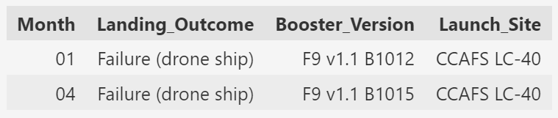
2015 Launch Records
Query:
List the records which will display the month names, failure landing outcomes in drone ship, booster versions, launch site for the months in year 2015.
SELECT SUBSTR(DATE,6,2) AS MONTH, LANDING_OUTCOME, BOOSTER_VERSION, LAUNCH_SITE FROM SPACEXTABLE WHERE LANDING_OUTCOME LIKE '%FAILURE%DRONE%' AND SUBSTR(DATE,0,5) ='2015’
This query shows that in January and in April of 2015 these were the only two launches with failure landing outcomes on drone ships.

Slide 35
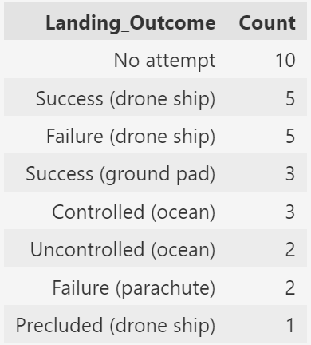
Rank Landing Outcomes Between 2010-06-04 and 2017-03-20
Query:
Rank the count of landing outcomes between the date 2010-06-04 and 2017-03-20, in descending order.
SELECT LANDING_OUTCOME, COUNT(*) AS COUNT FROM SPACEXTABLE WHERE DATE BETWEEN '2010-06-04' AND '2017-03-20' GROUP BY LANDING_OUTCOME ORDER BY COUNT DESC
This query shows that no attempt of landing outcome was the highest in count between the dates June 4, 2010 and March 20, 2017.

Slide 36

Section 3

Slide 37
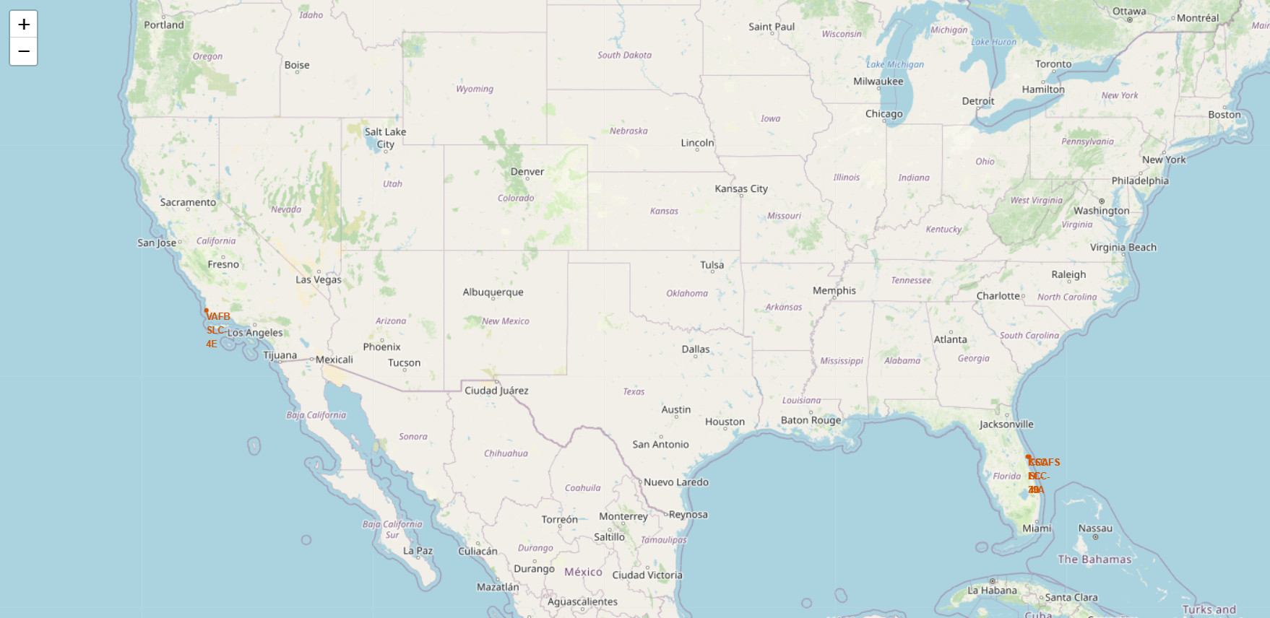
Launch Sites’ Markers on a Global Map
We can see Florida and California are where all the launch sites are located.

Slide 38
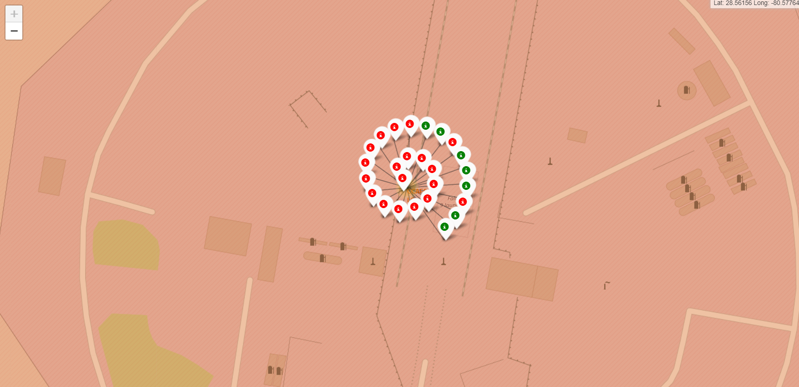
Color-labeled Launch Outcomes
We can see at this launch site, CCAFS LC-40, the launch outcomes tend to be failures.

Slide 39
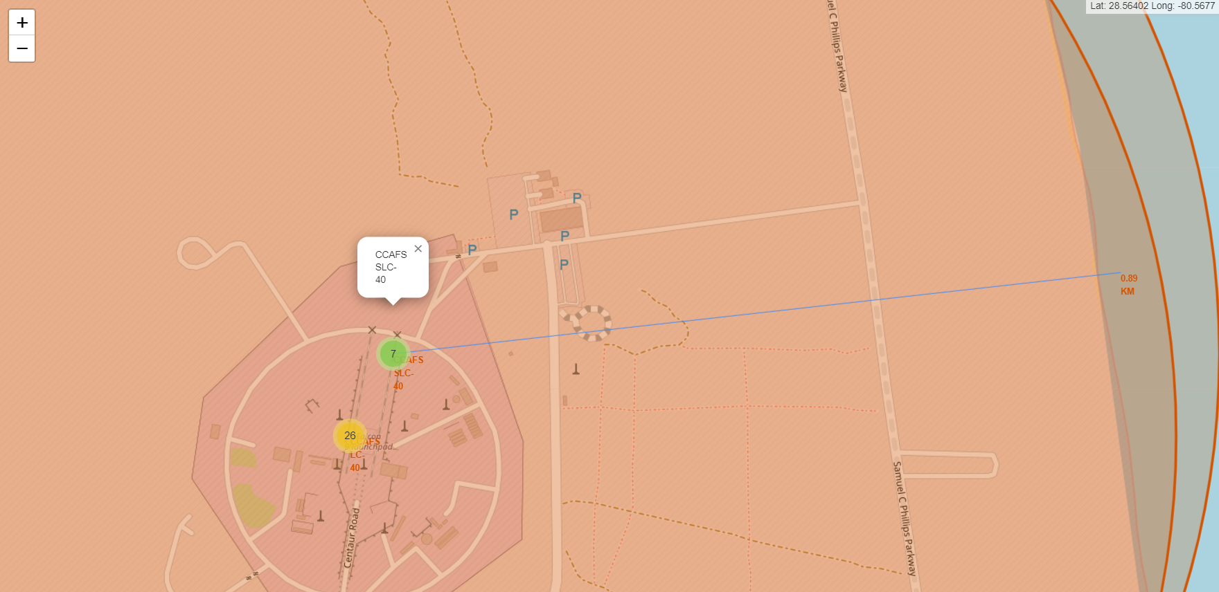
Launch Site and its Proximities to the Coastline
We can see at this launch site, CCAFS SLC-40, is approximately .89km from the coastline.

Slide 40

Section 4

Slide 41
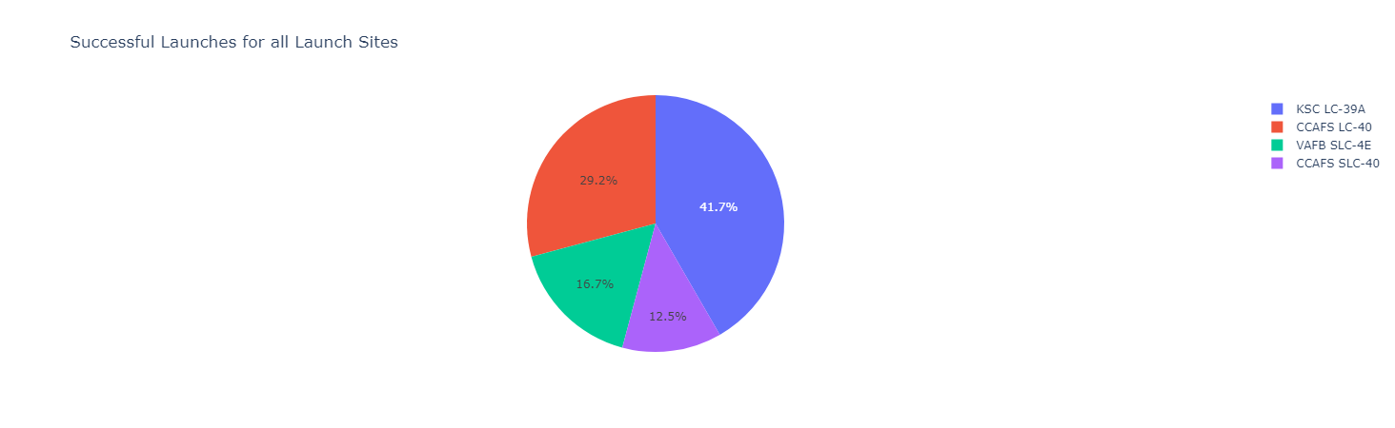
Launch Success Count for All Sites
The launch site with the highest launch success ratio is KSC LC-39A.

Slide 42
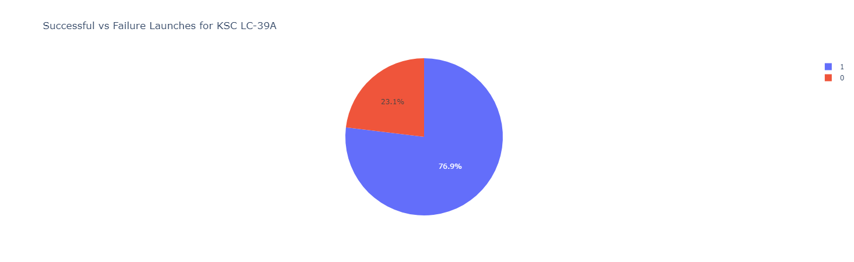
Launch Site with Highest Launch Success Ratio
KSC LC-39A has a success ratio of 76.9%

Slide 43
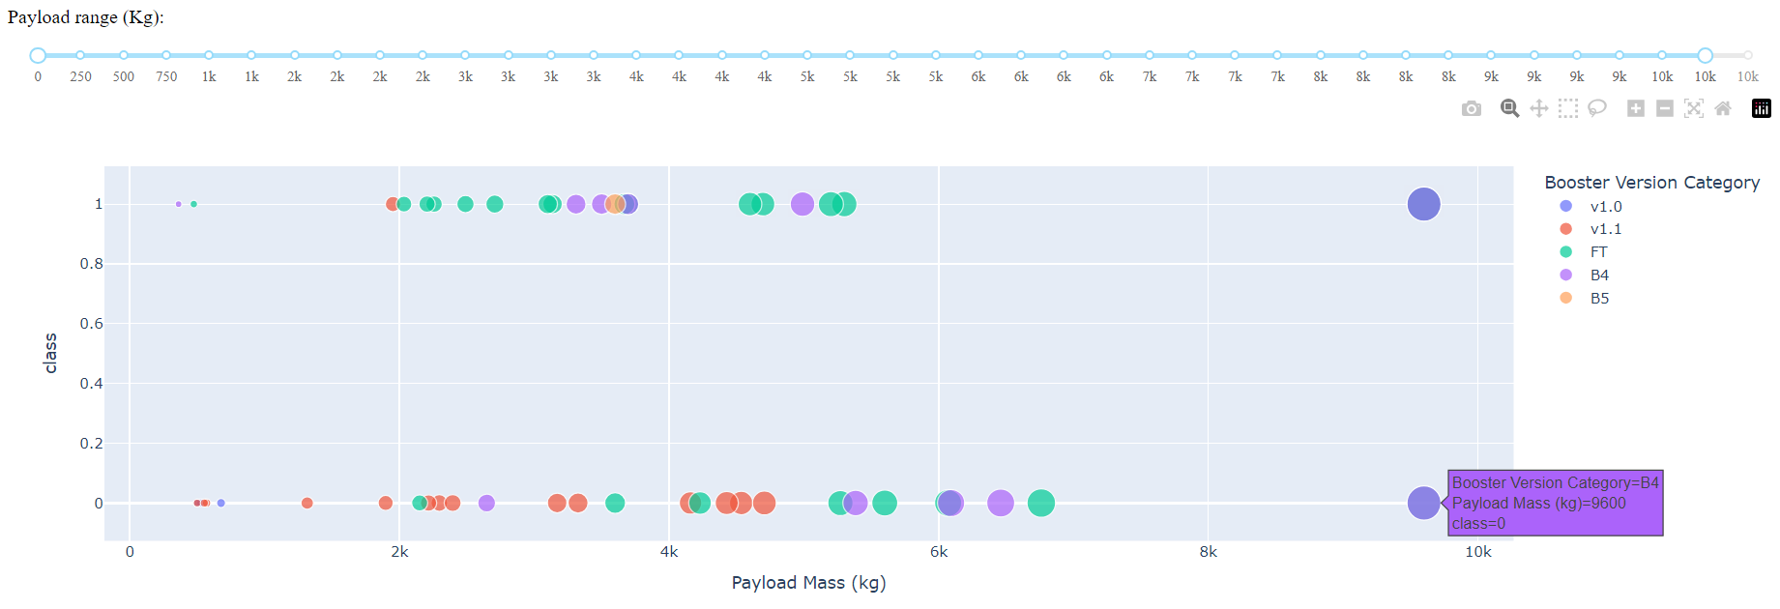
Payload vs. Launch Outcome
Shows all the launch sites booster version categories, their outcome (success/failure), and their payload mass.

Slide 44

Section 5

Slide 45
Classification Accuracy
The models used were:
Logistic Regression
Accuracy : 0.8464285714285713
Score: 0.8333333333333334
Support Vector Machine
Accuracy : 0.8482142857142856
Score: 0.8333333333333334
Decision Tree
Accuracy : 0.8892857142857145
Score: 0.9444444444444444
K-nearest Neighbor
Accuracy : 0.8482142857142858
Score: 0.8333333333333334

Slide 46

Confusion Matrix
In this confusion matrix, you can see that it incorrectly marked only 1 predicted outcome.
This confusion matrix was created using the decision tree model had the highest accuracy and best score.
Accuracy : 0.8892857142857145
Score: 0.9444444444444444

Slide 47
Conclusions
Exploratory Data Analysis (EDA) Results
Orbits that have been 100% successful were ES-L1, GEO, HEO, and SSO.
Learning that SSO has the most launch that were 100% successful.
Success rate was rising in 2013 – 2017, except 2014 where it was stable.
Most mission outcomes were successful except for 1 failure.
Predictive Analysis Results
The decision tree model had the highest accuracy and best score.
Accuracy : 0.8892857142857145
Score: 0.9444444444444444

Slide 48
Appendix
GitHub Link to complete project files: https://github.com/Avelazquez2/Data-Science-Courses/tree/main/Capstone

Slide 49


